Slide 1
Makefile Introduction

Slide 2
CONTENT
1 Overview of make
2 What is Makefiles?
3 Writing Makefiles
4 How to Run make
5 Writing Rules
6 Use Variables
7 Use Functions
8 Demo

Slide 3
Overview of make
PURPOSE:
Small programs all in some single files
“Not so small” programs :
Many people write
Multiple components
More than one programmer
Require coordination of files to build

Slide 4
Overview of make
Problems:
Long files are harder to manage
(for both programmers and machines)
Every change requires compilation of all constituent files?
Many programmers can not modify the
same file simultaneously
Large projects are not implemented in a single module/file

Slide 5
Overview of make
Solution : Separation of Concerns
Targets:
Manage project ease
Minimum compilation when something is changed
Easy maintenance of project structure, dependencies and creation

Slide 6
What is a makefile
Makefile is a script
containing shell commands
contains a list of rules, dependence, target, action.
Naming: Makefile, makefile, GNUmakefile.

Slide 7
Writing Makefile

Slide 8
Concepts
dependency
main.o: main.c sum.h
gcc -c main.c
Rule
tab
taget
action

Slide 9
A Simple Makefile
sum.c main.c
Sum.h
#include "stdio.h"
#include "sum.h"
int sum(int a, int b)
{
return a+b;
}
#include "stdio.h"
#include "sum.h"
void main(void)
{
int x=0;
x=sum(3,6);
printf("x=%d\n",x);
}
#ifndef SUM_H_
#define SUM_H_
int sum(int a, int b);
#endif /* SUM_H_ */

Slide 10
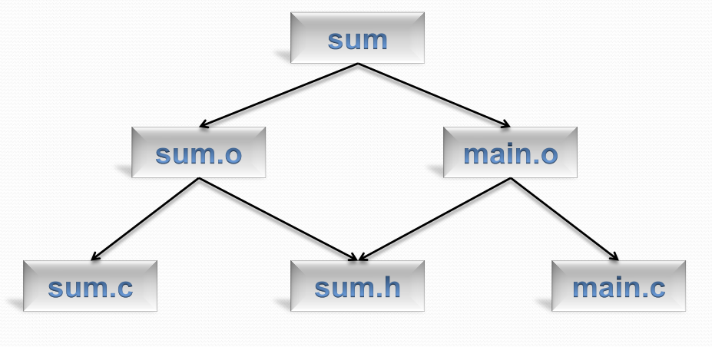
Diagram

Slide 11
A Simple Makefile
Makefile1
sum: main.o sum.o
gcc –o sum main.o sum.o
sum.o: sum.c sum.h
gcc -c sum.c
main.o: main.c sum.h
gcc -c main.c
run:
./sum
clean:
rm *o sum
@echo "clean done"

Slide 12
How to run make?

Slide 13
How to run make?
SYNOPSIS
make [ -f makefile ] [ options ] ... [ targets ] …
make executes commands in the makefile to update one or more target names, where name is typically a program. If no -f option is present, make will look for the makefiles GNUmakefile, makefile, and Makefile, in that order.

Slide 14
How to run make?
[ options ]
-f file: Use file as a makefile.
-i: Ignore all errors in commands executed to remake files.
-n: Print the commands that would be executed, but do not execute them.
More infomation: man make

Slide 15
How to run make?
[ Targets ]
all: Make all the top-level targets the makefile knows about.
Info: information of program
clean: Delete all files that are normally created by running make.
install: Copy the executable file into a directory that users typically search for commands
uninstall:
tar: Create a tar file of the source files.
print: Print listings of the source files that have changed.
test: Perform self tests on the program this makefile builds.

Slide 16
DEMO
Makefile1

Slide 17
The Variables in Makefile
Variables: CC=gcc
Variables Extra flags to give to the C compiler:
eg: CFLAGS+= -I./include -DDEBUG -Wall –g
LDFLAGS += -L./lib –lm
-I | Path to header files
-D | Define …
-Wall | Enable warning
–g | Enable debug in gcc compiler
-L./lib | Path to library
–lm | Math library

Slide 18
Automatic Variables
$@ | The file name of the target of the rule
$% | The target member name, when the target is an archive member
$< | The name of the first prerequisite
$? | The names of all the prerequisites that are newer than the target
$^ | The names of all the prerequisites
$+ | This is like ‘$^’, but prerequisites listed more than once are duplicated in the order they were listed in the makefile.
$| | The names of all the order-only prerequisites, with spaces between them.
$* | The stem with which an implicit rule matches.

Slide 19
The Function in Makefile
Function Call Syntax
$(function arguments) or ${function arguments}
$(wildcard pattern)
eg: CSRCS= $(wildcard *.c)
$(patsubst pattern,replacement,text)
eg: OBJS+= $(patsubst %.c, %.o, $(CSRCS))
$(shell dirname $@)
eg: @mkdir -p $(shell dirname $@)

Slide 20
Example Makefile 2
Makefile2
######## Specials Variables #######
.PHONY: sum, sum.o, main.o
############ DEFILE MACRO##########
TARGET=sum
HDRS= sum.h
CSRCS= $(wildcard *.c)
OBJSDIR=./build
OBJS+= $(patsubst %.c, $(OBJSDIR)/%.o, $(CSRCS))
CC=gcc
# flags pass into compiler
CFLAGS += -I./include -DDEBUG -Wall -g
LDFLAGS += -L./lib -lm
######## END DEFILE ##############
############ RULES ###############
#################### RULES ################
all: ${TARGET}
${TARGET} : $(OBJS)
$(CC) $(OBJS) -o $@ $(LDFLAGS) $(CFLAGS)
@echo "compile sum done"
$(OBJSDIR)/%.o: %.c $(HDRS)
mkdir -p $(shell dirname $@)
$(CC) -c $< -o $@ $(CFLAGS)
run:
./sum
clean:
@rm $(OBJSDIR)/*o sum
@rm -r $(OBJSDIR)
@echo "clean done"

Slide 21
DEMO
Makefile2

Slide 22
A Large Project

Slide 23
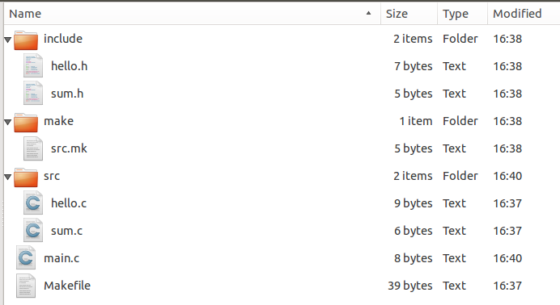
A large project

Slide 24
Makefile3
######### Specials Variables ##########
-include make/src.mk
.PHONY: sum, sum.o, main.o
#.RECIPEPREFIX =>
########### DEFILE MACRO ###############
#OUT=output
TARGET=sum
#HDRS+= include/sum.h
#HDRS+= include/hellomake.h
CSRCS+= main.c
OBJSDIR=build
OBJS+= $(patsubst %.c, $(OBJSDIR)/%.o, $(CSRCS))
CC=gcc
# flags pass into compiler
CFLAGS += -I./include -DDEBUG -g
LDFLAGS += -L./lib -lm
########## END DEFILE ##############
########### RULES ###############
all: $(TARGET)
$(TARGET): $(OBJS)
@mkdir -p $(shell dirname $@)
$(CC) $(OBJS) -o $@ $(CFLAGS) $(LDFLAGS)
@echo "compile done"
$(OBJSDIR)/%.o: %.c $(HDRS)
@mkdir -p $(shell dirname $@)
$(CC) -c $< -o $@ $(CFLAGS) $(LDFLAGS)
run:
@./sum
clean:
@rm $(OBJSDIR)/*o sum
@rm -r $(OBJSDIR)
@echo "clean done"

Slide 25
DEMO
Makefile3

Slide 26
Reference
http://www.gnu.org/software/make/manual/make.html
http://eslinuxprogramming.blogspot.com/

Slide 27
Thank You!

